Slide 1

Will Your State Pension be Enough?
Bridging the Pension Gap
National Life Group® is a trade name of National Life Insurance Company, Montpelier, VT, Life Insurance Company of the Southwest, Addison, TX, and their affiliates. Each company of National Life Group is solely responsible for its own financial condition and contractual obligations. Life Insurance Company of the Southwest is not an authorized insurer in New York
and does not conduct insurance business in New York. Agents are independent contractors and are not employees of
any National Life Group entity.
This presentation may not be recorded, copied, transmitted or otherwise disseminated using any device –
including but not limited to artificial intelligence note-taking platforms, webinar and browser recording functions,
and meeting recording software – without the express written permission of National Life Group.
The companies of National Life Group® and their representatives do not offer tax or legal advice.
Please encourage your clients to consult with their appropriate professional advisor.
TC8988565(0726)1 | Cat No 103231(0726)
© 2026, National Life Group
Notes:
Welcome & Introduction.
Preparing to present:
Use one of the following state slides as an example. Or, better yet, create a slide that is specific to your state.
If you create your own slide, personalize, or revise this presentation in any way, you must submit it through AdTrax for review and approval by the AGT prior to use.
. Representatives of Equity Services, Inc. need to submit all public speaking events for prior review and approval through the standard advertising approval process.
Detailed instructions are included in the Engage Toolkit.
For current salary data in all states, go to
https://www.nea.org/resource-library/educator-pay-and-student-spending-how-does-your-state-rank/teacher

Slide 2
Retirement Math
California
For a K-12 employee in California, the average annual:
  Salary: $103,552
  Pension benefit: $56,873
California Department of Education, Average Salaries & Expenditure Percentage, 2024–25; National Education Association, Educator Pay and Student Spending, 2024–25
Annual Comprehensive Financial Report for the fiscal year ended June 30, 2025, California State Teachers' Retirement System
Notes:
Knowing what your state’s “average pension” can be interesting. But this amount doesn’t necessarily reflect the amount that many teachers actually earn.

Slide 3
Retirement Math
Texas
For a K-12 employee in Texas, the average annual:
  Salary: $63,749
  Pension benefit: $27,804
Texas State Teachers Association / National Education Association, 2024–25 average Texas teacher salary, April 2025
Teacher Retirement System of Texas, Fund Insights / TRS Financial Facts, as of Aug. 31, 2025
Notes:
Knowing what your state’s “average pension” can be interesting. But this amount doesn’t necessarily reflect the amount that many teachers actually earn.

Slide 4
Retirement Math
Florida
For a K-12 employee in Florida, the average annual:
  Salary: $56,663
  Pension benefit: $27,199
National Education Association, Educator Pay Data 2026 / Rankings & Estimates, 2024–25 average teacher salary
Florida Retirement System Pension Plan Summary Plan Description, revised July 2025; estimate assumes Regular Class, 30 years of service, Option 1, and average final compensation equal to the 2024–25 average salary
Notes:
Knowing what your state’s “average pension” can be interesting. But this amount doesn’t necessarily reflect the amount that many teachers actually earn.

Slide 5
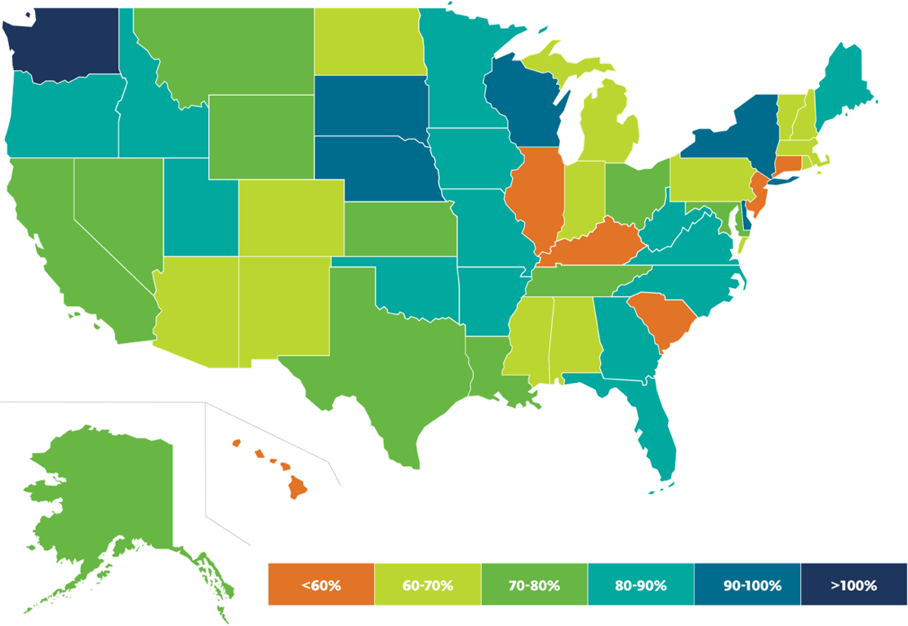
State Pension Funded Ratio Projection in 2024
11 states 90% funded¹
10 states 70% or less funded¹
1. Equable, Pension Plan Funded Ratio Rankings 2024, Jan 2025 https://equable.org/pension-plan-funded-ratio-rankings-2024/
Notes:
Each state’s funded ratio is a weighted average for the largest state-administrated pension plans in that particular state. A funded ratio is simply a measurement of how much a pension plan has saved relative to the benefits it has promised, the percentage is calculated by dividing the market value of assets by the actuarial value liabilities (i.e., the net present value of promised pension checks).
States that report fully funded pension plans (80% or more) are depicted in shades of blue. Funding ratios ranging from 60% to 79% are displayed in shades of green, while any state that falls below a 60% funded ratio appears in shades of orange.

Slide 6
The Life Expectancy Blindspot
Americans age 65 are
projected to live
18 - 21
more years.²
46%
of Americans have not tried
to calculate how much
money they will need to
have for retirement.³
$345K
Expected cost of
healthcare when retired.⁴
2. Social Security Administration, 2025 OASDI Trustees Report, Table V.A4, Period Life Expectancy.
3. Employee Benefit Research Institute and Greenwald Research, 2025 Retirement Confidence Survey.
4. Fidelity Investments, 2025 Retiree Health Care Cost Estimate, July 2025.
Notes:
Retirement is a major financial milestone for many individuals. However, there is a significant blind spot that many people have when it comes to retirement planning, which is the potential for living longer in retirement than they worked.
- In the past, we have seen people retire at age 65 and live for another 10 to 15 years. However, with the advancements in longevity science, people are living longer, and the idea of living 18 years or more in retirement is -- in my opinion -- underestimated.
- According to a 2025 Retirement Confidence Survey, a 65-year-old man today can expect to live, on average, until age 78, while a 65-year-old woman can expect to live until age 86. However, these numbers are just averages, and many people will live well into their 90s or even beyond. In fact, according to a 2024 Pew Research Center analysis of U.S. Census Bureau projections, the number of Americans ages 100 and older is expected to more than quadruple over the next 30 years, rising from about 101,000 in 2024 to roughly 422,000 by 2054.
U.S. centenarian population is projected to quadruple over the next 30 years, Pew Research Center, January 2024
https://www.pewresearch.org/short-reads/2024/01/09/us-centenarian-population-is-projected-to-quadruple-over-the-next-30-years/
- This increased life expectancy means that people will necessarily need to save more money for retirement, and the money they have will need to be preserved to help avoid running out of money.
-The 2025 healthcare estimate shown here is a remarkable 4% increase over 2024.
Fidelity Investments® Releases 2025 Retiree Health Care Cost Estimate, a Timely Reminder for All Generations to Begin Planning
https://newsroom.fidelity.com/pressreleases/fidelity-investments--releases-2025-retiree-health-care-cost-estimate--a-timely-reminder-for-all-gen/s/3c62e988-12e2-4dc8-afb4-f44b06c6d52e

Slide 7
Retirement Income Gap
Most pension plans are not designed to fully replace income.
As the cost-of-living increases, the income gap gets larger and larger.
Teacher Retirement System
This is a hypothetical example for illustrative purposes only
Notes:
Increases in inflation decrease purchasing power for everything from healthcare to food to utilities.

Slide 8

The Power of
Pretax Savings
Pre-tax salary deferral allows you to save more for retirement, pay less in taxes, and earn interest on a tax-deferred basis.
Distributions from pre-tax retirement plans are taxed as ordinary income and, if taken prior to reaching age 59½ may be subject to an additional 10% federal income tax penalty.
Notes:
Pre-tax savings gives you the benefit of triple compounding. Your contributions are made via salary deferral which allows you to save more while making a reduced change to your take home pay, additionally the pre-tax contribution decreases your taxable earnings which reduces the amount you will pay in taxes and you will earn tax-deferred interest on the money you would have otherwise paid in taxes.
Taxes are not due until funds are withdrawn from the plan, and people with lower income in retirement will likely find themselves in a lower tax-bracket in their retirement years.

Slide 9

The High Cost of Waiting
Do you have time or money?
The longer you wait to save for the future, the more you will need…to end up with the same amount or less.

Slide 10

The High Cost of Waiting
At age 25, Julie starts saving $350/month in her 403(b) plan and never increases contributions. Assuming 3% average annual interest she will have $326,185 at age 65.
Karen waits until 40 to start saving. If she contributes $350/month and never increases and earns the same annual average of 3%, her total at age 65 is only $157,722.
  If she doubles monthly contributions to $700/month, her total savings at age 65 will grow to $315,455, still less than if she had started earlier.
This is a hypothetical example, is used for illustrative purposes only, and is not the story of an actual client.This does not represent the actual results of any particular financial product
Notes:
Example: Karen (40) & Julie (25). Julie starts saving $350/month in her 403(b) plan, and never increases contributions. Assuming 3% average annual interest she will have $326,185 at age 65. Karen waits until 40 to start saving. If she contributes $350/month and never increases and earns the same annual average of 3%, her total at age 65 is only $157,722. If she doubles monthly contributions to $700/month, her total savings at age 65 will grow to $315, 455, still less than if she had started earlier.

Slide 11


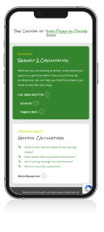

Take Action Now
RetirementHomeroom.com
Notes:
Some financial professionals believe that a retirement income of 70% to 80% of pre-retirement income is sufficient. While that may be true for some people, many will find that they are not happy with that level of income. Consider that, although it is easy to increase spending, it is quite another to reduce it. Retirees who take a 20% to 30% cut in pay will feel it in a reduced lifestyle.
Take action today, in order to give yourself peace of mind for the future. Let’s schedule a one-on-one meeting where we can review your personal pension benefits, identify ways to increase your retirement savings, and determine ways to reduce what you are paying in taxes.
To prepare for our meeting, visit RetirementHomroom.com to become more fluent in your retirement needs and goals.

Slide 12

Questions?

