Slide 1

Plan Today for a Financially Independent Tomorrow
Products Issued By:
Life Insurance Company of the Southwest®
National Life Group® is a trade name of National Life Insurance Company, Montpelier, VT, Life Insurance Company of the Southwest, Addison, TX, and their affiliates. Each company of National Life Group is solely responsible for its own financial condition and contractual obligations. Life Insurance Company of the Southwest is not an authorized insurer in New York and does not conduct insurance business in New York.
This presentation may not be recorded, copied, transmitted or otherwise disseminated using any device – including but not limited to artificial intelligence note-taking platforms, webinar and browser recording functions, and meeting recording software – without the express written permission of National Life Group.
The companies of National Life Group® and their representatives do not offer tax or legal advice. Please encourage your clients to consult with their appropriate professional advisor.
TC8363570(0925)1 | Cat No 106429(0925)

Slide 2

Why Fixed Indexed Annuities
Fundamentally tax-deferred retirement savings vehicle
Provides diversity in retirement savings that could potentially offset savings that participate in the market
Potential to grow with peace of mind that premiums paid and interest credited are protected from possible market loss with a 0% floor guarantee^{1,2,3}
Can provide death benefit protection
1. Guarantees are dependent upon the claims-paying ability of the issuing company.
2. Fixed Indexed annuities do not directly participate in equity investments.
3. Assuming no withdrawals during withdrawal charge period. Rider charges continue to be deducted regardless of whether interest is credited.

Slide 3
From National Life and Life Insurance Company of the Southwest
Longest Standing Issuer
#1 Issuer
#1 issuer of Fixed Indexed Annuities in Employer Sponsored Plans⁴
Longest standing issuer of Indexed Annuities⁵
4 LIMRA US Individual Annuity Industry Sales Report, 2Q2024
5 Insurance News Net, FIAs at Age 20, 2015

Slide 4
Solid Financial Strength Ratings
A+
A+
A1
(Superior)
A.M. BEST
Second highest of 16 rankings
(Strong)
STANDARD & POOR’S
Fifth highest of 21 rankings
(Good)
MOODY’S
Fifth highest of 21 rankings
Financial strength ratings for NLIC and LSW as of 9/11/2025
Ratings are subject to change.

Slide 5
When You Include Fixed Indexed Annuities in Your Retirement Strategy
Your FIA savings grows with:
Credit interest based on the performance of an index, like the S&P 500, without actually participating in the stock market
If the index goes down, your principal and interest earned are protected from loss
Upside Potential
Downside Protection
The 0% “floor” provided by an indexed annuity ensures that during crediting periods where the index is negative, that no less than 0% interest is credited to the index strategy. This means that premiums paid and interest earned won’t be reduced by market volatility.

Slide 6

Upside Potential
FIAs have the potential to outspace other fixed money products.
Interest is credited based on a formula that considers changes in a market index
When the index is positive, the interest credited has the potential to be higher than current interest rates⁶
6 Based on a Participation Rate or Cap that is declared in advance.

Slide 7

Annual Interest Rate Reset
Each year is a fresh start.
The annual reset allows interest accumulated to lock in and compound
The index’s year-end value becomes the next year’s year-start value

Slide 8

Downside Protection
Zero is your hero!
Interest is locked into accumulation value annually
Annual interest rate may earn 0% interest in a year, but never a negative amount due to index declines

Slide 9
National Life Group’s indexed policyholders…
…haven’t lost a penny of their policy value due to market conditions!
Fixed Indexed Annuities are guaranteed to:
NEVER
NEVER
NEVER
be assessed a mandatory fee
earn less than zero percent interest
lose a penny of your premiums paid and interest credited due to index declines⁷
7 Assuming no withdrawals during the withdrawal charge period. Rider charges continue to be deducted regardless of whether interest is credited. Annuities have surrender charges that are assessed during the early years of the contract if the contract owner surrenders the annuity. In addition, withdrawals prior to age 59½ may be subject to a 10% Federal Tax Penalty.

Slide 10
What’s Your Savings Objective?
Greatest upside interest crediting potential of our fixed indexed annuities for long-term savings accumulation > FLEX Secure Growth
5% Immediate Interest Bonus option to jumpstart savings, with the added ability to turn savings into a guaranteed stream of income that you cannot outlive using the Guaranteed Lifetime Income Rider (GLIR) > FLEX Select Income
Maximum Accumulation
Retirement Income

Slide 11

Retirement income that you cannot outlive
Guaranteed Lifetime Income Rider (GLIR) included in FLEX Select Income⁸
One-time Activation Bonus scales up payments when you are ready to start receiving income
Increasing income option hedges against inflation
8 Electing this rider incurs an additional cost. Guaranteed Withdrawal Payments reduce the policy's accumulated value, but you will continue to receive these payments during your lifetime even if your accumulation value declines to zero.

Slide 12

Save with Peace of Mind
Access when you need it most.
The Emergency Access Waiver allows you penalty-free access to your contributions in the event of unforeseen emergency or separation from service
TPA approval is required.
Emergency access waiver is available beginning in policy year two.

Slide 13
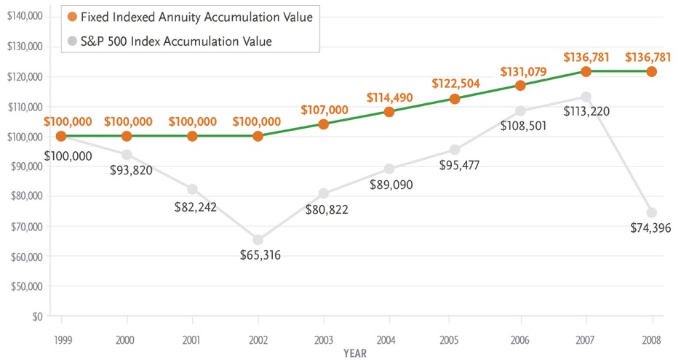
A Smooth Ride to Retirement
*Note: Chart is a hypothetical back cast of a Zenith Growth product first available June of 2023. This hypothetical example includes one of the most significant market declines in recent history to illustrate the benefits of the annuity “floor”. The 0% “floor” provided by an indexed annuity ensures that during crediting periods where the index is negative, that no less than 0% interest is credited to the index strategy. However, the contract’s “cap” also imposes a limit on the highest amount of interest that can be credited based in-part on an increase in the underlying index. This means that when the index experiences large gains the index crediting will never be greater than the cap even if the index itself experiences a higher return.
Hypothetical chart and graph assume $100,000 purchase payment allocated 100% to the S&P 500 Index Point-to-Point indexed account with no prior withdrawals, point-to-point interest crediting method, 9-year surrender charge schedule, and allocation date of January 3 starting in 2000. To simplify the example, this chart also assumes a consistent indexed interest cap rate for the 9-year period: 7%. Actual cap rates are subject to change and could be lower than the cap rate assumed on this hypothetical example, but will never be less than the minimum cap shown in your contract. For comparative purposes, the S&P 500 Index accumulation value shows the value of $100,000 starting on January 3, 2000 and ending on each annual allocation date that corresponds to the allocation date of the Horizon Growth contract values shown above, assuming the historical performance of the S&P 500 Index (without dividends) for each period shown. It is not intended to project or predict the future performance of any specific financial product. You cannot invest in an index.
Zenith Growth 10 indexed annuity, form series 20834, or state variation thereof and all associated riders are issued by Life Insurance Company of the Southwest (LSW). LSW is not an authorized insurer in New York and does not conduct insurance business in New York. Not all policies or riders are available in all states – please check with your agent regarding availability in your state. This advertising is not approved for use in DE, ID, OK, OR, WY.
The "S&P 500" is a product of S&P Dow Jones Indices LLC or its affiliates ("SPDJI") and S&P Opco, LLC and has been licensed for use by Life Insurance Company of the Southwest (“LSW”). Standard & Poor's® and S&P® are registered trademarks of Standard & Poor's Financial Services LLC ("S&P") and Dow Jones® is a registered trademark of Dow Jones Trademark Holdings LLC (''Dow Jones"). The trademarks have been licensed to SPDJI and have been sublicensed for use for certain purposes by LSW. The Zenith Growth 10 fixed indexed modified single premium deferred annuity (“the Product”) are not sponsored, endorsed, sold or promoted by SPDJI, Dow Jones, S&P, any of their respective affiliates (collectively, "S&P Dow Jones Indices"). Neither S&P Dow Jones Indices nor S&P Opco, LLC make any representation or warranty, express or implied, to the owners of the Product or any member of the public regarding the advisability of investing in securities generally or in the Product particularly or the ability of the S&P 500 to track general market performance. S&P Dow Jones Indices and S&P Opco, LLC’s only relationship to LSW with respect to the S&P 500 is the licensing of the Index and certain trademarks, service marks and/or trade names of S&P Dow Jones Indices and/or its licensors. The S&P 500 is determined, composed and calculated by S&P Dow Jones Indices or S&P Opco, LLC without regard to LSW or the Product. S&P Dow Jones Indices and S&P Opco, LLC have no obligation to take the needs of LSW or the owners of Product into consideration in determining, composing or calculating the S&P 500. Neither S&P Dow Jones Indices nor S&P Opco, LLC are responsible for and have not participated in the determination of the prices, and amount of Product or the timing of the issuance or sale of the Product or in the determination or calculation of the equation by which the Product is to be converted into cash, surrendered or redeemed, as the case may be. S&P Dow Jones Indices and S&P Opco, LLC have no obligation or liability in connection with the administration, marketing or trading of the Product. There is no assurance that investment products based on the S&P 500 will accurately track index performance or provide positive investment returns. S&P Dow Jones Indices LLC is not an investment advisor. Inclusion of a security within an index is not a recommendation by S&P Dow Jones Indices to buy, sell, or hold such security, nor is it considered to be investment advice.
NEITHER S&P DOW JONES INDICES NOR S&P OPCO, LLC GUARANTEES THE ADEQUACY, ACCURACY, TIMELINESS AND/OR THE COMPLETENESS OF THE S&P 500 OR ANY DATA RELATED THERETO OR ANY COMMUNICATION, INCLUDING BUT NOT LIMITED TO, ORAL OR WRITTEN COMMUNICATION (INCLUDING ELECTRONIC COMMUNICATIONS) WITH RESPECT THERETO. S&P DOW JONES INDICES AND S&P OPCO, LLC SHALL NOT BE SUBJECT TO ANY DAMAGES OR LIABILITY FOR ANY ERRORS, OMISSIONS, OR DELAYS THEREIN. S&P DOW JONES INDICES AND S&P OPCO, LLC MAKES NO EXPRESS OR IMPLIED WARRANTIES, AND EXPRESSLY DISCLAIMS ALL WARRANTIES, OF MERCHANTABILITY OR FITNESS FOR A PARTICULAR PURPOSE OR USE OR AS TO RESULTS TO BE OBTAINED BY LSW, OWNERS OF THE PRODUCT, OR ANY OTHER PERSON OR ENTITY FROM THE USE OF THE S&P 500 OR WITH RESPECT TO ANY DATA RELATED THERETO. WITHOUT LIMITING ANY OF THE FOREGOING, IN NO EVENT WHATSOEVER SHALL S&P DOW JONES INDICES OR S&P OPCO, LLC BE LIABLE FOR ANY INDIRECT, SPECIAL, INCIDENTAL, PUNITIVE, OR CONSEQUENTIAL DAMAGES INCLUDING BUT NOT LIMITED TO, LOSS OF PROFITS, TRADING LOSSES, LOST TIME OR GOODWILL, EVEN IF THEY HAVE BEEN ADVISED OF THE POSSIBILITY OF SUCH DAMAGES, WHETHER IN CONTRACT, TORT, STRICT LIABILITY, OR OTHERWISE. THERE ARE NO THIRD PARTY BENEFICIARIES OF ANY AGREEMENTS OR ARRANGEMENTS BETWEEN S&P DOW JONES INDICES AND LSW, OTHER THAN THE LICENSORS OF S&P DOW JONES INDICES.
A Hypothetical Performance Over Nine (9) Years*

Slide 14
Annual Interest Crediting Gives Upside Potential Plus Downside Protection*
Graph assumes $10,000 single premium.
The S&P 500 Index — shown as the dashed line — increases and decreases, as it might from year to year. Notice how the Flexible Premium Annuity protects the Accumulation Value (the principal and previously credited interest) — shown by the solid line — from the decreases. The Accumulation Value can only remain constant or increase; it can never decrease.†
* Illustration is not representative of future results nor of any applicable Index Rate.
† Withdrawals in the first policy year or withdrawals exceeding 10% of the Accumulation Value in years 2–10 will incur a Withdrawal Charge.

Slide 15
Flex Secure Growth fixed indexed annuity, form series 20934(0124)/ICC24-20934(0124), Flex Secure Growth Bonus fixed indexed annuity, form series 0934(0124)/ICC24-20934(0124), Flex Select Income fixed indexed annuity, form series 20934(0124)/ICC24-20934(0124), Guaranteed Lifetime Income Rider is form series 20934(0124)GLWB/ICC24-20934(0124)GLWB or a state variation thereof, Emergency Access Waiver rider form series 20375/ICC1820375(0418)EAW are issued by Life Insurance Company of the Southwest.

