Slide 1

Foreign National Underwriting
National Life Group® is a trade name of National Life Insurance Company, Montpelier, VT, Life Insurance Company of the Southwest, Addison, TX, and their affiliates. Each company of National Life Group is solely responsible for its own financial condition and contractual obligations. Life Insurance Company of the Southwest is not an authorized insurer in New York
and does not conduct insurance business in New York.
This presentation may not be recorded, copied, transmitted or otherwise disseminated using any device –
including but not limited to artificial intelligence note-taking platforms, webinar and browser recording functions,
and meeting recording software – without the express written permission of National Life Group.
The companies of National Life Group® and their representatives do not offer tax or legal advice.
Please encourage your clients to consult with their appropriate professional advisor.
TC8113280(0725)1 | Cat No 108333(0625)

Slide 2
What Makes National Life Group Unique?
Who is Considered a Foreign National?
Rules/Products

Slide 3

The NL Advantage: Foreign Nationals
No fluid underwriting for up to $3 million
Living Benefits for foreign nationals of
Countries A & B
No telephone interview regardless of
face amount
China is an A Country; best rating available
eApp; eDelivery; allows for Limited Power
of Attorney
Count EB-5 visa as Nexus
Allow students with F-1/F-2 visas
$15 million face amount; can consider higher with FAC insurance
AM Best A+, Moody’s A1, and S&P A+1
1. A.M. Best A+ (Superior) 2nd out of 16 ratings, Standard & Poors A+ (Strong) 5th out of 21 ratings, Moody’s A1 (Good) 5th out of 21 ratings. Ratings as of June 23, 2025. Ratings are subject to change.

Slide 4


Foreign National Business is Easy with National Life
Determine if a person is a foreign national
Establish a nexus for the person to the United States
Take the application!
Step 1
Step 2
Step 3

Slide 5
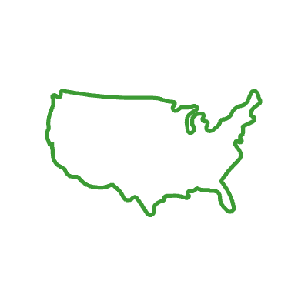

Who is Considered a Foreign National?
Any individual who lives outside the U.S.
for more than 4 consecutive months in a
12-month period. This includes U.S. citizens
living abroad.
Any persons that have been in the U.S. for an
8-month period in 12 consecutive months with
the expectation of staying in the U.S. for the foreseeable future.

Slide 6

Nexus to the United States
Foreign national insureds and owners (if the insured does not own the policy) must have verifiable proof of one or more of the following connections/nexus to the United States:
Own real property in the U.S.
Own a business in the U.S.
Married to a U.S. citizen who resides in the U.S.
Student in the U.S. on F-1/F-2 visa (a copy of the valid visa must be submitted with the application)
Proposed insured must have significant documented U.S. assets (minimum $100,000) in the U.S. for at least 3 months. Note that very large face amounts may require larger U.S. assets to justify the desired coverage
Possession of EB-5 visa

Slide 7
Taking the Application
Ages 18–70
Available Products
  Total Secure Whole Life
  Basic Secure Universal Life
  Flex Life Indexed Universal Life
  PeakLife Indexed Universal Life
  SummitLife Indexed Universal Life
Solicitation must take place in the U.S.
Applications and underwriting requirements must be completed, signed, and dated in the U.S. in English
Premium financing is allowed¹ (subject to guidelines)
Policy must be delivered in the U.S.; Limited Power of Attorney for Proposed Owner is acceptable for delivery,
form 20524
Foreign National Questionnaire required
For A & B countries up to $15 million face amount. Higher amount considered with Facultative Insurance.
Accelerated Benefit Riders are available for A & B countries only*
For more detailed information, see to Foreign National Guidelines
1 This business strategy is offered and managed by an independent third party. No National Life Group company nor anyone acting on its behalf has evaluated the strategy or the suitability of using life insurance in connection with the strategy. No National Life Group company nor anyone acting on its behalf is authorized to make any representation regarding the suitability, effectiveness or legality of the strategy. Please have the customer consult with their own advisors regarding whether this strategy is appropriate for their situation. Premium financing is offered and administered independently of the insurance company that issues the policy. The insurance company is bound only by the terms of the life insurance contract. Premium financing relies on internal policy funding to pay back the loan. This is not guaranteed and results may be more or less favorable than illustrated. The ability to internally fund a life insurance contract will be dependent upon the performance of the contract and is not guaranteed. If remaining policy values and scheduled premiums are insufficient, additional out-of-pocket payments may be needed to keep the policy in force or to repay the loan.
* Accelerated Benefit Riders are optional and may not be available in all states or on all products. Receipt of Accelerated Benefits will reduce the Cash Value and Death Benefit otherwise payable under the policy, may result in a taxable event, and may affect your client's eligibility for public assistance programs.

Slide 8


Resources
Planning for Foreign Nationals
Available in:
English # 103418
Spanish #103571
Chinese #103570
Foreign National Guidelines
Available in:
English # 69798
Spanish #103104
Chinese #103058

