Slide 1


30-Year
Retirement Plan
Balance Risk With Potential Future-Proof Strategies
Presented by [Rep Name]

Slide 2
Please include your approved ESI disclosures, registered Branch address and phone numbers.
Registered Representatives of Equity Services, Inc. do not offer tax or legal advice. For advice concerning your own unique situation, please consult your appropriate professional advisor.

Slide 3



Retiree Expenses
How do you determine how much income you’ll need in retirement?
Do you use a
“rule of thumb”?
Essential Expenses
  Food
  Housing
  Health
Discretionary Expenses
  Vacations
  Dining Out
60%?
70%?
80%?
How long is the average retirement? 30 years….
Notes:
Today we’re focusing on financial risk and how to manage it.
When talking about saving for retirement, how do you determine how much money you’ll need? Maybe use a traditional rule of thumb and say 60, 70, or 80%?
When setting your goals for retirement income consider starting with two components instead of a rule of thumb: expenses and retirement length.
Your expenses can be split into two categories: essential and discretionary. Essential expenses cover your basic needs, like food, housing and health. Discretionary expenses are for the activities and items that you want, but don’t necessarily need, like vacations and dining out.
So how long do should we plan on meeting those expenses? How long is the average retirement? Many experts suggest you should plan for 30 years. A lot can change in 30 years. Let’s try an exercise. Think about all of the revolutionary changes – good and bad – that you have witnessed over the last 30 years. In 2000, only 1% of U.S. adults had a high-speed broadband internet service at their house. Today that number is 80% with the most significant increase happening within a short timeframe during the 2000 -2010 decade. *. Can you imagine life without internet access? Recognizing that so much can change in 30 years – even just 10 years - , the question becomes how do we manage 30 years of potential financial risk?
*Pew Research Center, Internet, Broadband Fact Sheet 2024 Demographics of Internet and Home Broadband Usage in the United States | Pew Research Center

Slide 4




How Long Will Your Retirement Last?
65-Year-Old Woman
  75% chance of living to age 80
  50% chance of living to age 85
65-Year-Old Man
  75% chance of living to age 75
  50% chance of living to age 83
65-Year-Old Couple
  25% chance of living to age 95
Source: LIMRA Retirement Income Reference, 2024
Notes:
The statistics don’t lie. Planning for a longer retirement is essential. [review slide]

Slide 5

So, How Do You Manage 30 Years of Risk?
Notes:
So how do you manage 30 years of risk?

Slide 6
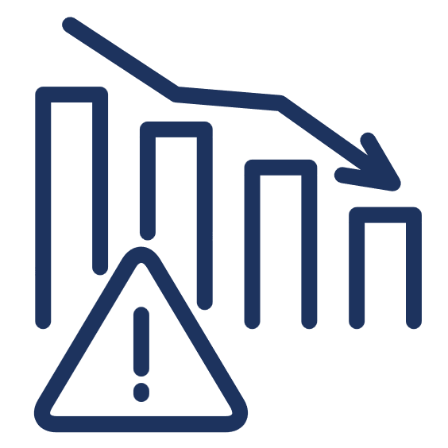
The Risk Factor
Market Risk
Risks Facing Retirees

Slide 7
Sequence of Return Risk: 1999-2021
5% adjusted for inflation annually
MARKET RISK
Scenario A
Beginning balance
of $1,000,000.
Income distributions begin in a
down market.
Scenario B
Beginning balance
of $1,000,000.
Income distributions begin in an
up market.
Age | Return | Distribution | Acct Value (EOY)
65 | 0.00% | $50,000 | $950,000
66 | -10.14% | $51,500 | $802,170
67 | -13.04% | $53,045 | $644,522
68 | -23.37% | $54,636 | $439,261
69 | 26.38% | $56,275 | $498,862
70 | 8.99% | $57,964 | $485,746
71 | 3.00% | $59,703 | $440,616
72 | 13.62% | $61,494 | $439,135
73 | 3.53% | $63,339 | $391,297
74 | -38.49% | $65,239 | $175,448
75 | 23.45% | $67,196 | $149,395
76 | 12.78% | $69,212 | $99,276
77 | 0.00% | $71,288 | $27,988
78 | 13.41% | $31,741 | $0
79 | 29.60% | $0 | $0
80 | 11.39% | $0 | $0
81 | -0.73% | $0 | $0
82 | 9.54% | $0 | $0
83 | 19.42% | $0 | $0
84 | -6.24% | $0 | $0
85 | 28.88% | $0 | $0
86 | 16.26% | $0 | $0
87 | 26.89% | $0 | $0
Age | Return | Distribution | Acct Value (EOY)
65 | 0.00% | $50,000 | $950,000
66 | 26.89% | $51,500 | $1,153,955
67 | 16.26% | $53,045 | $1,288,543
68 | 28.88% | $54,636 | $1,606,038
69 | -6.24% | $56,275 | $1,449,546
70 | 19.42% | $57,964 | $1,673,084
71 | 9.54% | $59,703 | $1,772,993
72 | -0.73% | $61,494 | $1,698,557
73 | 11.39% | $63,339 | $1,828,684
74 | 29.60% | $65,239 | $2,304,736
75 | 13.41% | $67,196 | $2,546,605
76 | 0.00% | $69,212 | $2,477,393
77 | 12.78% | $71,288 | $2,722,716
78 | 23.45% | $73,427 | $3,287,766
79 | -38.49% | $75,629 | $1,946,676
80 | 3.53% | $77,898 | $1,937,495
81 | 13.62% | $80,235 | $2,121,146
82 | 3.00% | $82,642 | $2,102,138
83 | 8.99% | $85,122 | $2,205,999
84 | 26.38% | $87,675 | $2,700,266
85 | -23.37% | $90,306 | $1,978,909
86 | -13.04% | $93,015 | $1,627,844
87 | -10.14% | $95,805 | $1,366,976
Source: Standard & Poor’s Financial Services LLC (S&P), a subsidiary of The McGraw-Hill Companies, Inc., 2021.
All investing involves risk, including the potential loss of principal, and there can be no guarantee that any investing strategy will be successful. Past performance is no guarantee of future results and actual results will vary. The S&P Composite Index of 500 stocks (S&P 500®) is a group of unmanaged securities widely regarded by investors to be representative of large company stocks in general. All indices are unmanaged, and you cannot invest directly in any market index. Investments, unlike indices, involve fees, expenses and charges.
Notes:
When it comes to market risk for retirees, when you retire can be a significant factor. This is called is Sequence of Return risk. Simply, this is a risk that the market will decline significantly early in retirement, which significantly reduces your retirement nest egg. The significant reduction in value – in addition to the annual distributions – could cause the nest egg to deplete quicker than planned.
In this example, we can clearly demonstrate the risk. We have the same 22-year time period, 1999-2021. In scenario A, we begin retirement in the year 1999. In Scenario B, we start retirement in 2021 and work in reverse. The same returns for each scenario, the only difference is when the returns are realized.
Scenario A: There are major early losses, which significantly impair the account. While Scenario B realizes early gains, which is a significant boost to the account. Showing the same $50,000 annual distribution, Scenario A runs out of income at age 78, adjusted for 5% annual inflation, while Scenario B with the same annual distribution still is projecting $1.367 for the account value at age 87.

Slide 8

The Risk Factor
Market Risk
Inflation Risk
Risks Facing Retirees

Slide 9
Historical Inflation: Everyday Expenses
INFLATION RISK
A Dozen Eggs
148% increase
202% increase
Avg. Price for
a Gallon of Gas
Sources: Average Cost of a Dozen Eggs, 2024: https://www.sofi.com/learn/content/average-cost-of-a-dozen-eggs; Average Annual Retail Fuel Price of gas, 2024: Alternative Fuels Data Center: Maps and Data - Average Annual Retail Fuel Price of Gasoline (energy.gov)
Notes:
When we think about inflation, we generally talk about our every day purchases. Things like stamps, a bottle of Coke, a dozen eggs or a gallon of gas. We can see from this chart that over the last 30 years, inflation most certainly exists. However, do we really feel inflation if we are spending $2.51 for a dozen eggs?

Slide 10
Historical Inflation: Big Ticket Items
INFLATION RISK
213% increase
242% increase
Sources: Avg. Cost of a New Car in 2023, Statista, 2024 ; Avg. Cost of a New Car in 1990, Energy.gov, 2012
Avg. Cost of a New Home in 1990 vs. 2023, Yahoo Finance/GoBanking Rates, 2024
Notes:
I would argue that we realize the impact of inflation on our big purchases. Let’s consider buying a car. Over the last 30 years, the average price for a new car has increased 204%. If we look at an even bigger purchase, a new constructed home, the average price has increased 183% since 1990. That’s great if you are the builder, but not so great if you are the buyer.

Slide 11

The Risk Factor
Market Risk
Inflation Risk
Unknown Risk
Risks Facing Retirees

Slide 12


Unknown Risks
UNKNOWN RISK
Nearly 95%
6 in 10
of adults 60
and older have at least one chronic condition; nearly 80% have two
or more.¹
of adults 60 and older have at least one chronic condition; nearly 80% have two
or more.²
A stroke occurs every 40 seconds
in the U.S.³
66.5%
2024
of all personal bankruptcies are medical bankruptcies.⁴
First time new U.S. cases of cancer are expected to cross the 2M mark: ~5,500 cancer diagnoses a day.⁴
1 National Council on Aging, https://www.ncoa.org/article/the-top-10-most-common-chronic-conditions-in-older-adults, April 2022.
2 Centers for Disease Control and Prevention, https://www.cdc.gov/chronicdisease/index.htm, May 2023
3 Centers for Disease Control and Prevention, https://www.cdc.gov/stroke/facts.htm, April 2022
4 Retire Guide, https://www.retireguide.com/retirement-planning/risks/medical-bankruptcy-statistics, 2023
5 The American Cancer Society, https://www.cancer.org/research/acs-research-news/facts-and-figures-2024.html, Jan. 2024

Slide 13
The Risk Factor
Market Risk
Inflation Risk
Unknown Risk
Risks Facing Retirees
How do you manage these risks?
Balance Risk with Potential
Future-Proof Strategies

Slide 14
Potential Future-Proof Strategy: Annuities
FUTURE-PROOF STRATEGY #1
BALANCING MARKET RISK
Fixed Indexed Annuities
Bank CDs
Treasuries
Stronger interest-crediting potential, no market risk, guaranteed income
Principal Protection and Minimal Yield Potential
Principal Protection and Minimal Yield Potential
Risk
Opportunity risk and low returns
Opportunity risk and low returns
Some opportunity risk
Return Potential
Indexed annuities have withdrawal charges that are assessed during the early years of the contract if the annuity is surrendered. Indexed annuities do not directly participate in any stock or equity investments. Guarantees are dependent on the claims paying ability of the issuing company.
Notes:
To address market risk and help ensure you can meet essential expenses, there are a few solutions that may offer lower risk than many securities as well as guarantees, though not guaranteed against market volatility.
Bank CDs can offer principal protection, but their yield today is minimal.
The principal and interest payments of treasuries are backed by the U.S. Government. For this reason they are considered a lower risk investment, but they are still subject to market risk if you were to sell them on the secondary market, and to interest rate risk, plus their yield potential today is only slightly higher than bank CDs.
Fixed indexed annuities credit interest based in part on the change in a market index, giving them the potential for higher interest crediting than traditional fixed annuities. The 0% “floor” provided by an indexed annuity ensures that during crediting periods where the index is negative, that no less than 0% interest is credited to the index strategy. This means that premiums paid and interest earned won’t be reduced by market volatility, although any rider charges will continue to be deducted even if no interest is credited.

Slide 15


Potential Future-Proof Strategy: Investment Based Portfolios
BALANCING INFLATION RISK
9.90%
2.53%
Average return of the S&P 500 index over the last 30 years.¹
Average return of inflation over
the last 30 years.²
1 What is the Avg Stock Market Return? , SoFi Learn, 2024.
2 Historical Inflation Rates, Consumer Price Index 1993-2023, updated 2024
All indices, like the S&P 500, are unmanaged and you cannot invest directly in any market index. Investments, unlike indices, involve fees, expenses and charges.

Slide 16
Potential Future-Proof Strategy: Investment-Based Portfolios
BALANCING INFLATION RISK
Diversified Equity
Diversified Equity with Income
Balanced
Equity
Balanced
Diversified Income
Return Potential
Income
Capital Preservation
ESI Illuminations Portfolios
Risk
Notes:
Historically, equities have been the instrument that most efficiently competes with inflation.
In this chart, we see our portfolio platform. Return potential is the Y axis and Risk is the X axis. As we go up the line, the investment objectives get progressively more aggressive.

Slide 17
Potential Future-Proof Strategy: Permanent Life Insurance with Living Benefits
BALANCING THE UNKNOWN RISK
Whole Life Insurance /
Indexed Universal Life Insurance
High Yield Debt
In addition, Death Benefit Potential tax benefit
Living Benefits
Treasuries
High yield potential
Return Potential
Potential for higher cash values
Liquidity
and principal protection
Default risk
Opportunity
cost risk
Not available to everyone and cost of insurance
Risk
Living benefits may be provided by riders which are supplemental benefits that can be added to a life insurance policy and are not suitable unless you also have a need for life insurance. Riders are optional, may require additional premium and may not be available in all states or on all products. This is not a solicitation of any specific insurance policy. Policy loans and withdrawals reduce the policy’s cash value and death benefit and may result in a taxable event. Surrender charges may reduce the policy’s cash value in early years.
Notes:
When thinking about life insurance and the role it can play in retirement income planning, consider where cash value life insurance falls in terms of risk and return.
On one end of the spectrum, we have Treasuries, which offer principal protection but very little yield potential.
At the other end of the spectrum, we have high yield debt, which offers the potential of high yield return, but has the risk of potential default.
Cash value life insurance lies in the middle of the spectrum, offering the potential of higher interest crediting than treasuries. The downside is that not all clients will be able to afford the insurance or will even be insurable. But for clients looking to transfer some of that unknown risk, cash value life insurance offers a death benefit, the potential to access the cash value to supplement income using policy loans and withdrawals, living benefits, and potential tax benefits.

Slide 18




What is a Market Index?
While an investment cannot be made directly into a market index, it is used to track the performance of a group of stocks or other investments over time to give an indication of the overall performance of the market.
Downside Protection
Guaranteed 0% or 1% interest crediting floors in the event of a decline in the index.
Upside Potential
Based on the positive growth of a market index.

Slide 19
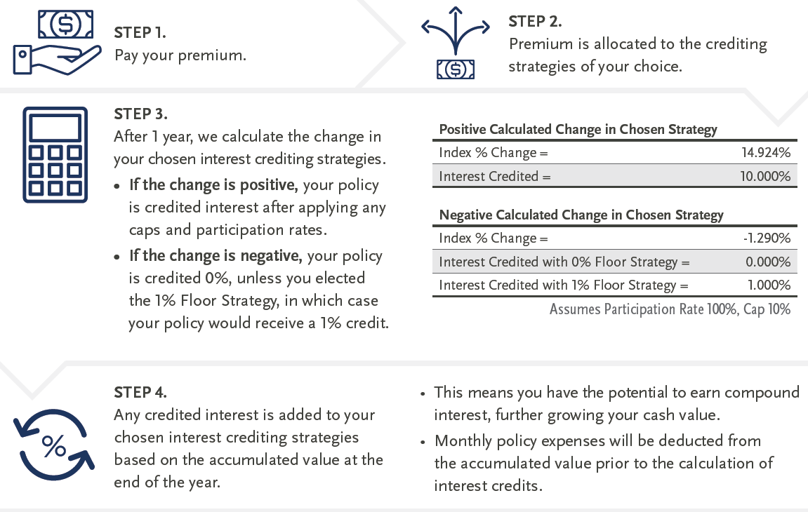
Life Insurance with Upside Potential, Downside Protection
Understanding Indexing with Indexed Universal Life

Slide 20
Total Financial Risk Management
Market Risk
Inflation Risk
Unknown Risk
Risks Facing Retirees
How do you manage these risks?
Balance Risk with Potential
Future-Proof Strategies
Fixed Indexed Annuities
Investment-Based Portfolios
Life Insurance
Notes:
So, when thinking about retirement income, consider the financial risks your retirement faces and think about utilizing multiple financial solutions – such as annuities, managed money utilizing investments and life insurance – to help mitigate that risk.

Slide 21

Thank you!

