Slide 1

Bridging the Gap
National Life Group® is a trade name of National Life Insurance Company, Montpelier, VT, Life Insurance Company of the Southwest, Addison, TX, and their affiliates. Each company of National Life Group is solely responsible for its own financial condition and contractual obligations. Life Insurance Company of the Southwest is not an authorized insurer in New York
and does not conduct insurance business in New York.
This presentation may not be recorded, copied, transmitted or otherwise disseminated using any device –
including but not limited to artificial intelligence note-taking platforms, webinar and browser recording functions,
and meeting recording software – without the express written permission of National Life Group.
The companies of National Life Group® and their representatives do not offer tax or legal advice.
Please encourage your clients to consult with their appropriate professional advisor.
TC7967607(0525)3 | Cat No 105205(0525)
© 2025, National Life Group
Notes:
Thank you for attending. Today we will talk about bridging the retirement gap.

Slide 2


What IS the Retirement Gap?
Teachers’ pension
Social Security
The Income You Have
The Income You Want
Notes:
So, what is the gap. Put very simply, it is the difference from the income you want to have compared to the income you will have in retirement.

Slide 3
How Big is the Gap?
Only
More than
Nearly
The gap must be made up your personal savings.
1 in 5
Half
40%
teachers gets a
full pension.¹
of people who teach never get any kind of pension.¹
of teachers, at the
moment, are not covered
by Social Security.²
These sources of money are:
Pretax
To be used for medical expenses
The Retirement Gap
1 Why Congress Should Extend Social Security to All Teachers, The74, November 2024
2 Pension Plan Funded Ratio Rankings 2024, January 2025
Notes:
To understand how large the gap could be, you have to first understand the teachers pensions and Social Security were not intended to be a replacement for your preretirement income. Also, what you will receive is still taxed and has to cover medical insurance as well.
Sources:
1 https://www.yahoo.com/news/why-congress-extend-social-security-153000817.html
2 https://equable.org/pension-plan-funded-ratio-rankings-2024

Slide 4
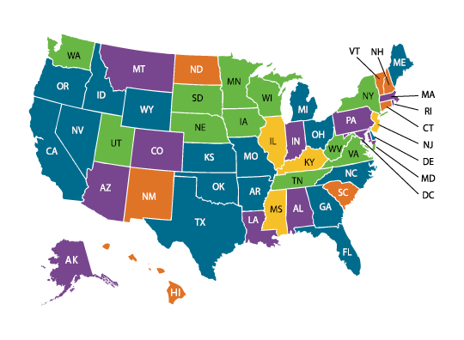
State Pensions Adapting to Economic Downturns
States have modified pensions in the past economic challenges.
Pension Plan Funded Ratio Rankings 2024
 | >90%
 | 80%-90%
 | 70%-80%
 | 60%-70%
 | 50-60%
The further away you are from retirement the greater the chance your benefit may change
3 Pension Plan Funded Ratio Rankings 2024, January 2025
Notes:
Many people think that once you are employed, your state pension benefit is locked in; it is not. The financial stresses seen in the markets since 2002 have placed many pensions in a state of under-funding leading them to modify benefits to future retirees.
Source:
3 https://equable.org/pension-plan-funded-ratio-rankings-2024/

Slide 5

What is My Gap?
Go to www.SSA.gov to estimate Social Security benefit
Go to your teachers pension website to estimate benefit
Google an interest calculator to estimate what your savings will grow to
Determine annual retirement income needed compared to payout of income sources
Comprehensive analysis of your retirement benefits
Estimate savings needed to reach your goals
Show you savings options that fit your needs and have options for income
Discover It Yourself
Allow Me to Build a Retirement Strategy for You
© 2025, National Life Group
5
Notes:
To see what your gap could be, you have a few choices. One is that you can determine your needed income in retirement. Then go to the Social Security web site to get an estimated benefit. Go to state pension and read how to determine your income and calculate it. Lastly, estimate how much the savings you have may grow to over time. Add up your income sources and subtract that from the income you want to find your gap.
Or allow me to build you a retirement strategy. I will do a review of your benefits, estimate your savings need and show you options that you are comfortable with.

Slide 6

Together for Your Retirement Success
[Agent Name]
[Agent Phone]
[Agent Email]

