Slide 1

Plan Today for a Financially Independent Tomorrow
Products Issued By:
Life Insurance Company of the Southwest®

Slide 2

Why Fixed Indexed Annuities
Fundamentally tax-deferred retirement savings vehicle
 |  | Provides diversity in retirement savings that could potentially offset savings that participate in the market
 |  | Potential to grow with peace of mind that premiums paid and interest credited are protected from possible market loss with a 0% floor guarantee^{1,2,3}
 |  | Can provide death benefit protection
1. Guarantees are dependent upon the claims-paying ability of the issuing company.
2. Fixed Indexed annuities do not directly participate in equity investments.
3. Assuming no withdrawals during withdrawal charge period. Rider charges continue to be deducted regardless of whether interest is credited.
Copyright© 2023, National Life Group | 2

Slide 3
From National Life and
Life Insurance Company of the Southwest
Longest Standing Issuer
#1 Issuer
#1 issuer of Fixed Indexed Annuities in Employer Sponsored Plans⁴
Longest standing issuer of Indexed Annuities⁵
4 LIMRA US Individual Annuity Industry Sales Report, 2Q2024
5 Insurance News Net, FIAs at Age 20, 2015

Slide 4
Solid Financial Strength Ratings
A+
A+
A1
(Superior)
A.M. BEST
Second highest of
16 rankings
(Strong)
  STANDARD & POOR’S
  Fifth highest of
  21 rankings
(Good)
MOODY’S
Fifth highest of
21 rankings
Financial strength ratings for NLIC and LSW as of 9/6/2024
Ratings are subject to change.

Slide 5
When You Include Fixed Indexed Annuities in Your Retirement Strategy
Your FIA savings grows with:
 |  | Upside Potential
 |  | Credit interest based on the performance of an index, like the S&P 500, without actually participating in the stock market
 |  | Downside Protection
 |  | If the index goes down, your principal and interest earned are protected from loss
The 0% “floor” provided by an indexed annuity ensures that during crediting periods where the index is negative, that no less than 0% interest is credited to the index strategy. This means that premiums paid and interest earned won’t be reduced by market volatility.

Slide 6

Upside Potential
FIAs have the potential to outspace other fixed money products.
 |  | Interest is credited based on a formula that considers changes in a market index
 |  | When the index is positive, the interest credited has the potential to be higher than current interest rates⁶
6 Based on a Participation Rate or Cap that is declared in advance.
Copyright© 2024, National Life Group | 6

Slide 7

Annual Interest Rate Reset
Each year is a fresh start.
 |  | The annual reset allows interest accumulated to lock in and compound
 |  | The index’s year-end value becomes the next year’s year-start value
Copyright© 2024, National Life Group | 7

Slide 8

Downside Protection
Zero is your hero!
 |  | Interest is locked into accumulation value annually
 |  | Annual interest rate may earn 0% interest in a year, but never a negative amount due to index declines
Copyright© 2024, National Life Group | 8

Slide 9
National Life Group’s indexed policyholders…
…haven’t lost a penny of their policy value due to market conditions!
Fixed Indexed Annuities are guaranteed to:
NEVER
NEVER
NEVER
be assessed a
mandatory fee
earn less than zero
percent interest
lose a penny of your premiums paid and
interest credited due
to index declines⁷
7 Assuming no withdrawals during the withdrawal charge period. Rider charges continue to be deducted regardless of whether interest is credited. Annuities have surrender charges that are assessed during the early years of the contract if the contract owner surrenders the annuity. In addition, withdrawals prior to age 59½ may be subject to a 10% Federal Tax Penalty.

Slide 10

What’s Your Savings Objective?
Maximum Accumulation
Greatest upside interest crediting potential
of our fixed indexed annuities for long-term savings accumulation > FIT Secure Growth
Retirement Income
5% Immediate Interest Bonus option to jumpstart savings, with the added ability
to turn savings into a guaranteed stream
of income that you cannot outlive using the Guaranteed Lifetime Income Rider (GLIR)
> FIT Select Income

Slide 11

Retirement income that you cannot outlive
 |  | Guaranteed Lifetime Income Rider (GLIR) included in FIT Select Income⁸
 |  | One-time Activation Bonus scales up payments when you are ready to start receiving income
 |  | Increasing income option hedges against inflation
8 Electing this rider incurs an additional cost. Guaranteed Withdrawal Payments reduce the policy's accumulated value, but you will continue to receive these payments during your lifetime even if your accumulation value declines to zero.
Copyright© 2024, National Life Group | 11

Slide 12

Save with Peace of Mind
Access when you need it most.
 |  | The Emergency Access Waiver allows you penalty-free access to your contributions in the event of unforeseen emergency or separation from service
TPA approval is required.
Emergency access waiver is available beginning in policy year two.
Copyright© 2024, National Life Group | 12

Slide 13
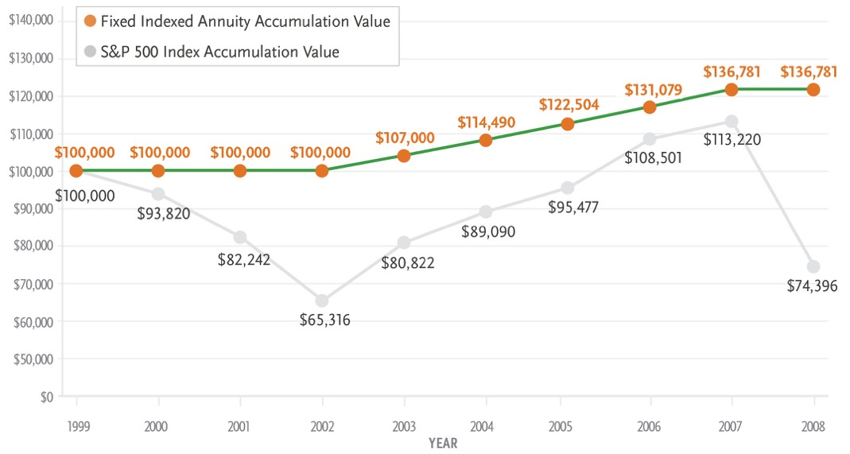
A Smooth Ride to Retirement
A Hypothetical Performance Over Nine (9) Years*
*Note: Chart is a hypothetical back cast of a Zenith Growth product first available June of 2023. This hypothetical example includes one of the most significant market declines in recent history to illustrate the benefits of the annuity “floor”. The 0% “floor” provided by an indexed annuity ensures that during crediting periods where the index is negative, that no less than 0% interest is credited to the index strategy. However, the contract’s “cap” also imposes a limit on the highest amount of interest that can be credited based in-part on an increase in the underlying index. This means that when the index experiences large gains the index crediting will never be greater than the cap even if the index itself experiences a higher return.
Hypothetical chart and graph assume $100,000 purchase payment allocated 100% to the S&P 500 Index Point-to-Point indexed account with no prior withdrawals, point-to-point interest crediting method, 9-year surrender charge schedule, and allocation date of January 3 starting in 2000. To simplify the example, this chart also assumes a consistent indexed interest cap rate for the 9-year period: 7%. Actual cap rates are subject to change and could be lower than the cap rate assumed on this hypothetical example, but will never be less than the minimum cap shown in your contract. For comparative purposes, the S&P 500 Index accumulation value shows the value of $100,000 starting on January 3, 2000 and ending on each annual allocation date that corresponds to the allocation date of the Horizon Growth contract values shown above, assuming the historical performance of the S&P 500 Index (without dividends) for each period shown. It is not intended to project or predict the future performance of any specific financial product. You cannot invest in an index.
FIT Horizon Growth indexed annuity, form series 20710(0320), or state variation thereof and all associated riders are issued by Life Insurance Company of the Southwest (LSW). LSW is not an authorized insurer in New York and does not conduct insurance business in New York. Not all policies or riders are available in all states – please check with your agent regarding availability in your state. This advertising is not approved for use in DE, ID, OK, OR, WY.
“Standard & Poor's®”, “S&P®”, “S&P 500®”, “Standard & Poor's 500”, and “500” are trademarks of The McGraw-Hill Companies, Inc. and have been licensed for use by Life Insurance Company of the Southwest. The product is not sponsored, endorsed, sold or promoted by Standard & Poor's and Standard & Poor's makes no representation regarding the advisability of purchasing the product.

Slide 14
Annual Interest Crediting Gives
Upside Potential Plus Downside Protection*
Graph assumes $10,000 single premium.
The S&P 500 Index — shown as the dashed line — increases and decreases, as it might from year to year. Notice how the FIT Flexible Premium Annuity protects the Accumulation Value (the principal and previously credited interest) — shown by the solid line — from the decreases. The Accumulation Value can only remain constant or increase; it can never decrease.†
* Illustration is not representative of future results nor of any applicable Index Rate.
† Withdrawals in the first policy year or withdrawals exceeding 10% of the Accumulation Value in years 2–10 will incur a Withdrawal Charge.

Slide 15
FIT Secure Growth and Select Income fixed indexed annuities, form series
20375(0418)/ICC18-20375(0418), Guaranteed Lifetime Income Rider form series
20367(0518)/ICC-18-20367(0518), Emergency Access Waiver rider form series
20375/ICC1820375(0418)EAW are issued by Life Insurance Company of the Southwest.

Slide 16


