Slide 1

Will Your State Pension be Enough?
Bridging the Pension Gap
Notes:
Welcome & Introduction.
Preparing to present:
Use one of the following state slides as an example. Or, better yet, create a slide that is specific to your state.
If you create your own slide, personalize, or revise this presentation in any way, be sure you submit it to AdReview@nationallife.com for review prior to use. Representatives of Equity Services, Inc. need to submit all public speaking events for prior review and approval through the standard advertising approval process.
Detailed instructions are included in the Engage Toolkit.
For current salary data in all states, go to
NEA Teacher Pay & Per Student Spending 2023 Rankings & Estimates Report, April 2023
https://www.nea.org/resource-library/educator-pay-and-student-spending-how-does-your-state-rank/teacher
For current teacher pension data go to
Equable Teacher Pensions in 2022, September 2022
https://equable.org/teacher-pensions-in-2022/ or
Reason Foundation Projecting the Funded Ratios of State-managed Pension Plans, July 2022
https://reason.org/data-visualization/projecting-the-funded-ratios-of-state-managed-pension-plans/
Note to presenter:
Open your another window to www.RetirementHomeroom.com so you can share state-specific pages if applicable. These websites include all the features of the National version, as well as state-specific messaging and resources.
California https://www.retirementhomeroom.com/?loc=California
Colorado https://www.retirementhomeroom.com/?loc=Colorado
Florida https://www.retirementhomeroom.com/?loc=florida
Minnesota https://www.retirementhomeroom.com/?loc=Minnesota
Ohio https://www.retirementhomeroom.com/?loc=ohio
Oregon https://www.retirementhomeroom.com/?loc=Oregon
Pennsylvania https://www.retirementhomeroom.com/?loc=Pennsylvania
Washington (State) https://www.retirementhomeroom.com/?loc=Washington
Wisconsin https://www.retirementhomeroom.com/?loc=wisconsin

Slide 2

Retirement Math
California
 |  | For a K-12 employee in California, the average:
 |  | Salary: $88,508 Pension benefit: $38,292
Notes:
Knowing what your state’s “average pension” can be interesting. But this amount doesn’t necessarily reflect the amount that many teachers actually earn.
Source:
Fast Facts About CalPERS Pensions, March 2023
https://news.calpers.ca.gov/fast-facts-about-calpers-pensions-2/

Slide 3

Retirement Math
Texas
 |  | For a K-12 employee in Texas, the average:
 |  | Salary: $58,887 Pension benefit: $25,764
Notes:
Knowing what your state’s “average pension” can be interesting. But this amount doesn’t necessarily reflect the amount that many teachers actually earn.
Source:
Texas American Federation of Teachers Press Release: Hat in Hand, April 2023
https://www.texasaft.org/releases/hat-in-hand-retired-texas-teachers-forced-to-beg-for-pension-relief-in-worlds-9th-largest-economy/

Slide 4
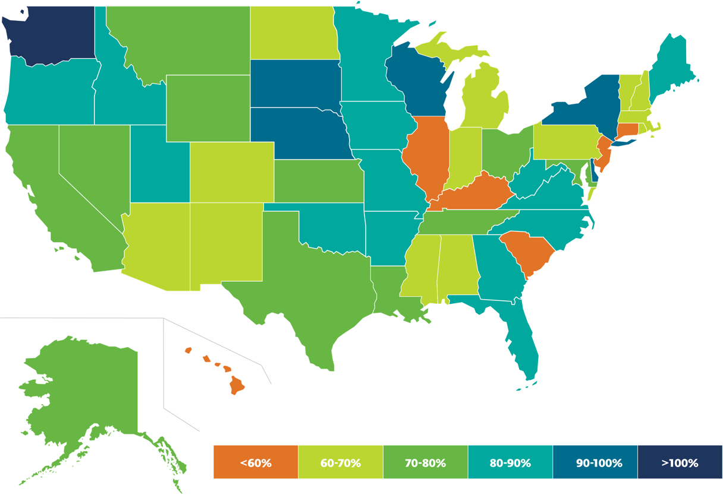
State Pension Funded Ratio Projection in 2022
 |  | 5 States:
 |  | 90% Funded
 |  | 19 States:
 |  | 70% or less funded
Source: Reason Foundation Projecting the Funded Ratios of State-Managed Pension Plans, July 2022
Notes:
Each state’s funded ratio is a weighted average for the largest state-administrated pension plans in that particular state. A funded ratio is simply a measurement of how much a pension plan has saved relative to the benefits it has promised, the percentage is calculated by dividing the market value of assets by the actuarial value liabilities (i.e., the net present value of promised pension checks).
States that report fully funded pension plans (80% or more) are depicted in shades of blue. Funding ratios ranging from 60% to 79% are displayed in shades of green, while any state that falls below a 60% funded ratio appears in shades of orange.
Source:
Reason Foundation Projecting the Funded Ratios of State-managed Pension Plans, July 2022
https://reason.org/data-visualization/projecting-the-funded-ratios-of-state-managed-pension-plans/

Slide 5



The Life Expectancy Blindspot
Average life expectancy has risen by
16 years
since the national retirement age was
set at 65.
42%
of Americans have not tried to calculate how much money they will need to have for retirement.
$315K
Expected cost of healthcare when retired.
What Is the Ideal Retirement Age for Your Health? April, 2023
Longevity: The Retirement Problem No One Is Discussing, April 2023
Fidelity, How to plan for rising health care costs, August 2022
Notes:
Retirement is a major financial milestone for many individuals. However, there is a significant blind spot that many people have when it comes to retirement planning, which is the potential for living longer in retirement than they worked.
In the past, we have seen people retire at age 65 and live for another 10 to 15 years. However, with the advancements in longevity science, people are living longer, and the idea of living 15 years or more in retirement is -- in my opinion -- underestimated.
According to a 2019 study by the Centers for Disease Control, a 65-year-old man today can expect to live, on average, until age 76, while a 65-year-old woman can expect to live until age 81. However, these numbers are just averages, and many people will live well into their 90s or even beyond. In fact, according to a 2016 PEW Research study, the number of people living to 100 years old is increasing rapidly.
This increased life expectancy means that people will necessarily need to save more money for retirement, and the money they have will need to be preserved to help avoid running out of money
Longevity: The Retirement Problem No One Is Discussing, April 2023
https://www.kiplinger.com/retirement/longevity-the-retirement-problem-no-one-is-discussing
To date, the oldest person to ever live was Jeanne Calment, a French woman who died in 1997 at age 122 years and 164 days old.
Such extreme longevity, according to new research by the University of Washington, likely will continue to rise slowly by the end of this century, and estimates show that a lifespan of 125 years, or even 130 years, is possible.
University of Washington, How long can a person live? The 21st century may see a
record-breaker, July 2021
https://www.washington.edu/news/2021/07/01/how-long-can-a-person-live-the-21st-century-may-see-a-record-breaker/
Average life expectancy has risen by 16 years since the national retirement age was set at 65.
What Is the Ideal Retirement Age for Your Health? April, 2023
https://www.nytimes.com/2023/04/03/well/live/retirement-age-health.html
A 65-year old couple retiring in 2022 can expect to spend $315,000 in health care and medical expenses throughout retirement according to Fidelity’s
……………….
Fidelity, How to plan for rising health care costs, August 2022
https://www.fidelity.com/viewpoints/personal-finance/plan-for-rising-health-care-costs

Slide 6
Retirement Income Gap
 |  | Most pension plans are not designed to fully replace income.
 |  | As the cost-of-living increases, the income gap gets larger and larger.
Notes:
Increases in inflation decrease purchasing power for everything from healthcare to food to utilities.
For detailed context, reference
Longevity: The Retirement Problem No One Is Discussing, April 2023
https://www.kiplinger.com/retirement/longevity-the-retirement-problem-no-one-is-discussing

Slide 7

The Power of Pretax Savings
 |  | Pre-tax salary deferral allows you to save more for retirement, pay less in taxes, and earn interest on a tax-deferred basis.
 |  | Distributions from pre-tax retirement plans are taxed as ordinary income and, if taken prior to reaching age 59½ may be subject to an additional 10% federal income tax penalty.
Notes:
Pre-tax savings gives you the benefit of triple compounding. Your contributions are made via salary deferral which allows you to save more while making a reduced change to your take home pay, additionally the pre-tax contribution decreases your taxable earnings which reduces the amount you will pay in taxes and you will earn tax-deferred interest on the money you would have otherwise paid in taxes.
Taxes are not due until funds are withdrawn from the plan, and people with lower income in retirement will likely find themselves in a lower tax-bracket in their retirement years.

Slide 8

The High Cost of Waiting
 |  | Do you have time or money?
 |  | The longer you wait to save for the future, the more you will need…to end up with the same amount or less.

Slide 9

The High Cost of Waiting
At age 25, Julie starts saving $350/month in her 403(b) plan, and never increases contributions. Assuming 3% average annual interest she will have $326,185 at age 65.
A
Karen waits until 40 to start saving. If she contributes $350/month and never increases and earns the same annual average of 3%, her total at age 65 is only $157,722. If she doubles monthly contributions to $700/month, her total savings at age 65 will grow to $315,455, still less than if she had started earlier.
B
Hypothetical example for illustrative purposes only — not representative of any particular investment.
Notes:
Example: Karen (40) & Julie (25). Julie starts saving $350/month in her 403(b) plan, and never increases contributions. Assuming 3% average annual interest she will have $326,185 at age 65. Karen waits until 40 to start saving. If she contributes $350/month and never increases and earns the same annual average of 3%, her total at age 65 is only $157,722. If she doubles monthly contributions to $700/month, her total savings at age 65 will grow to $315, 455, still less than if she had started earlier.

Slide 10

Take Action Now
RetirementHomeroom.com
“Saving for Retirement: The Quest for Success” February 03, 2022, https://www.investopedia.com/articles/retirement/05/061305.asp
Notes:
Some financial advisors believe that a retirement income of 70% to 80% of pre-retirement income is sufficient. While that may be true for some people, many will find that they are not happy with that level of income. Consider that, although it is easy to increase spending, it is quite another to reduce it. Retirees who take a 20% to 30% cut in pay will feel it in a reduced lifestyle.
Source:
“Saving for Retirement: The Quest for Success” February 03, 2022, https://www.investopedia.com/articles/retirement/05/061305.asp
Take action today, in order to give yourself peace of mind for the future. Let’s schedule a one-on-one meeting where we can review your personal pension benefits, identify ways to increase your retirement savings, and determine ways to reduce what you are paying in taxes.
To prepare for our meeting, visit RetirementHomroom.com “Retirement 101” tab to become more fluent in your retirement needs and goals.

Slide 11

Questions?

